Slide 1

www.TheIMI.org.uk/autocity
IMI Business and Enterprise Competition: Design the Future
Sponsored by Sytner Group

Slide 2
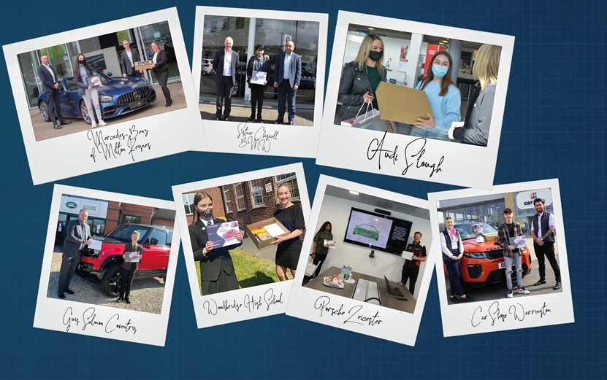
A message from our sponsors at Sytner Group
Work with some of the world’s most exciting brands!
Sytner Group is the UK’s largest prestige motor retail group. We provide an outstanding diverse and inclusive working environment, along with exciting career opportunities!
Be part of a team that is as unique as the cars we sell.

Slide 3
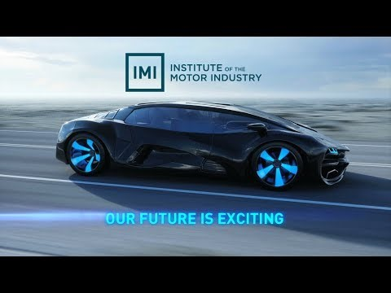
Our future is exciting…
Be part of it

Slide 4

The brief
We want you to design the vehicle of the future for 2030 with a specific target market in mind. Over the last 100 years cars have come a long way in fact most of the companies you know today would not have existed. We would like you to research and think about what vehicles will look like in in the future to support these individuals and help us shape the future of the industry.
Notes:
Either individually or in teams of 4-6 work together to research, design, market and pitch your new vehicle. Keep in mind your target audience and use your unique selling point (USP) to make your car stand out for the crowd!
Finally send in a copy of your presentation or pitch to careers@theimi.org.uk or post it in, for it to be marked by the panel of industry judges. You and your team may win the top prize of an exciting automotive day out with the IMI and the competition sponsors Sytner Group!

Slide 5

Job roles explored
Task 1: RESEARCH AND DEVELOPMENT understanding your target market with planning and research
Task 2: ENGINEER problem solving and creating your USP
Task 3: DESIGN designing your vehicle
Task 4: MARKETING branding your vehicle with logo and strapline
Task 5: COMMUNIATIONS design the marketing campaign and launch event
Task 6: SALES produce short video on vehicle – dragons’ den or elevator pitch
Notes:
Within this competition you will be able to try out different career options also during the tasks.

Slide 6

Task 1: Planning & Research
Choose a target audience and an issue to fix from the ones below.
Planning: You will need to research their preferences, lifestyles, hobbies, and finances etc.
Notes:
Choose a target audience and an issue to fix from the ones below. If you have another problem, you would like to help people overcome then explain their needs and requirements below.
Planning
You will need to research their preferences, lifestyles, hobbies, and finances etc.

Slide 7
Planning
Choose a target audience and an issue to fix from the ones below. If you have another problem, you would like to help people overcome then explain their needs and requirements below
Scenario 1
Scenario 2
Scenario 3
Design a new public transport of the future – how can you entice more people to use public transport more, reduce their need for a personal vehicle and become more eco-friendly?
How will you support a single person living in a city with limited parking and income to be able to afford a vehicle within a restricted emissions zone?
A Family of 5 who are concerned about sustainability, impact on the environment and safety for their family.

Slide 8
Scenario 4
Scenario 5
Scenario 6
An older couple who live in a retirement home, they have pets and are concerned about their future health needs.
A new type of Heavy Vehicle that can transporting goods long distances and that is environmentally friendly as well as safe and a comfortable environment for the driver.
Design a brand-new mode of transport for shared use for office for staff who work from home and come into the office weekly. They need a mode of transport that is available to them to get from the train station to the office which is 3 miles away.

Slide 9
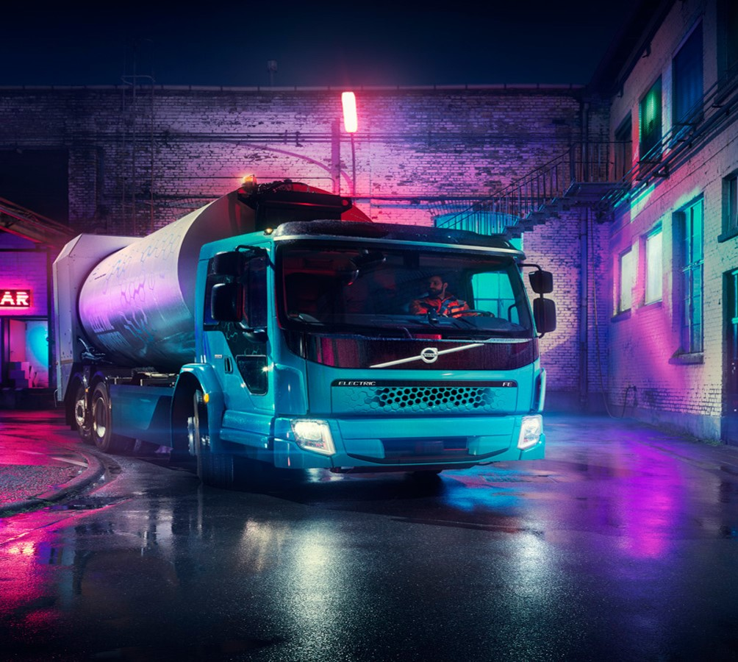

What do they have now?
What is available to your target audience now?
What do you think they will need in the future?
What are the main sustainability concerns of this target market?
What are the current sustainability measures on offer?
Research: What do they want?
Research the types of vehicles already available to your chosen target audience and consider what this will look like in the future.
What are the main concerns and issues that your target audience need to overcome?

Slide 10
You have 20 mins to plan and research your ideas

Slide 11

Task 2: Problem Solving
Key Features & Your Unique Selling Point (USP)
Now that you know your target audience and their requirements you need to come up with some key features and a ‘unique selling point’ that will make them choose to buy your vehicle and not one from a competitor.
Explain your unique selling point
Why will this will support and help your target audience?
Explain your sustainability or environmental impact with your new vehicle

Slide 12
You have 20 mins to problem solve and plan your USP

Slide 13
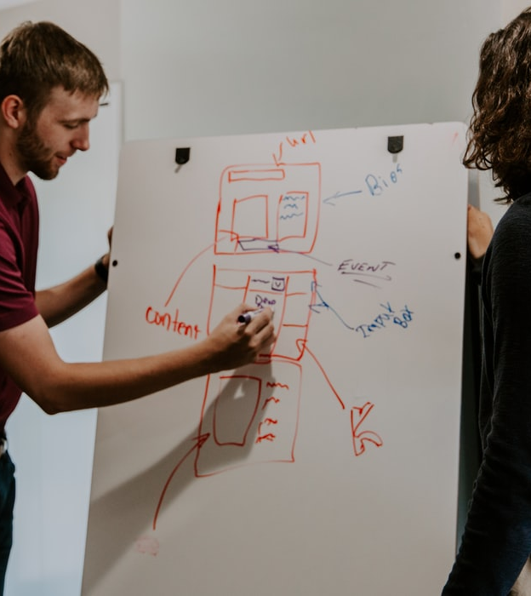
Task 3: Design
Show us your final image of your new vehicle, remember to highlight the key features, USP and how your vehicle will be sustainable!

Slide 14
You have 20 mins to design your vehicle

Slide 15

Task 4: Marketing
Now you know who your audience is, what their needs are and how your vehicle will fit them it’s time to name your vehicle. What will appeal to your audience and what will showcase your USP?

Slide 16
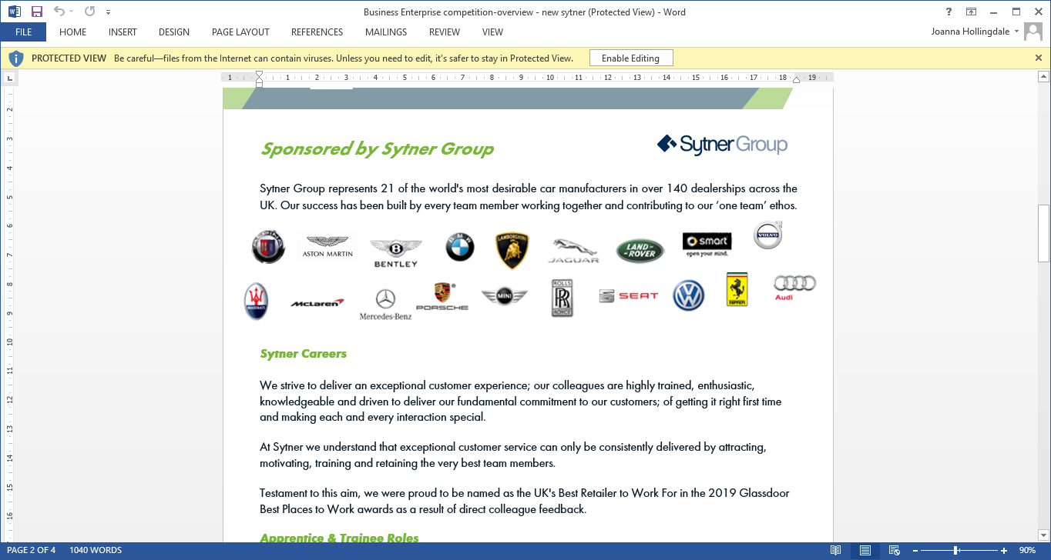
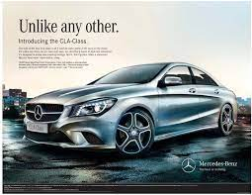
Marketing
Name, Design and Strap lines
Name your vehicle
Design your logo
Design your vehicle strap line
You will need to think of a marketing strapline for promoting your vehicle keeping in mind your target audience

Slide 17
You have 20 mins to name your vehicle, design the logo and create a strap line

Slide 18

Task 5: Communication
Advertising your vehicle
You will want to promote your new vehicle to the general public and an advertising poster is a great way of doing this.

Slide 19
Marketing & Communications
Launching your vehicle to the market
Plan an advertising poster
Plan your media campaign
Plan a product launch event
Design an advertising poster and advertising campaign
Devise a promotional plan by creating a media campaign to launch the vehicle onto the market
Tell us how you plan to launch the new vehicle onto the market
How will you launch your product?
Where will your launch event be?
What will happen at your launch event?
Who is your brand ambassador?

Slide 20
You have 20 mins to plan your marketing campaign

Slide 21
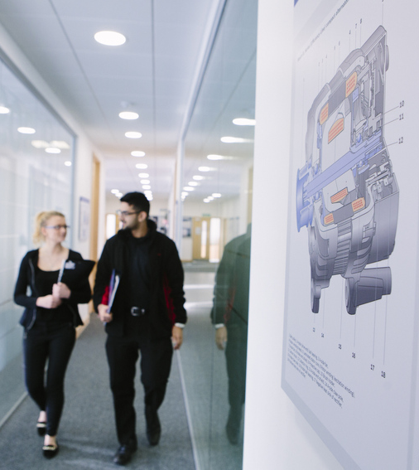
Task 6: Sales
Your product is ready for the big launch … now to focus on ‘selling’ your vehicle!
Are you ready?
Now it’s time to get all your ideas and plans together to create a final presentation for your new vehicle.
You can complete the competition using any of the following formats:
A PowerPoint presentation
A written presentation on A4 paper
A filmed 5 minute ‘elevator pitch’ of your ideas

Slide 22
You have 20 mins to prepare and sell your vehicle

Slide 23

Congratulations!
You have now designed, marketed and launched a brand new vehicle of the future!
Now send your ideas into careers@theimi.org.uk for your chance to win an amazing prize with Sytner Group.
On behalf of the future…. Thank you!

Slide 24
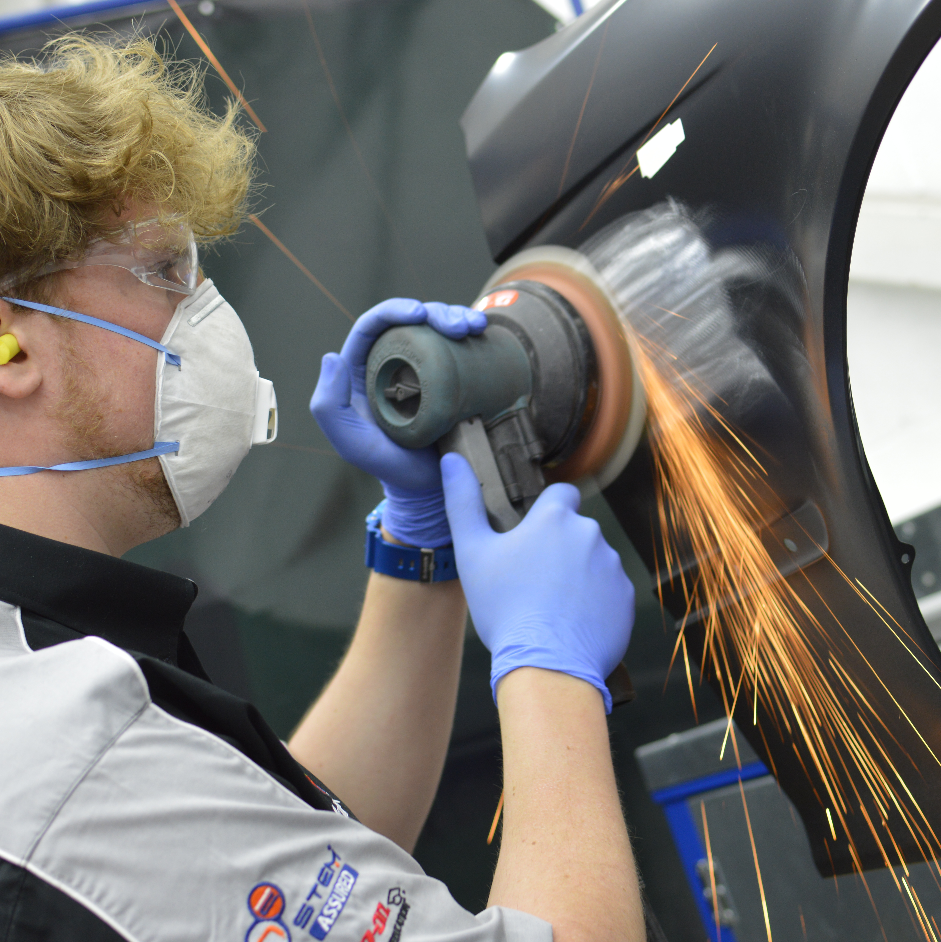
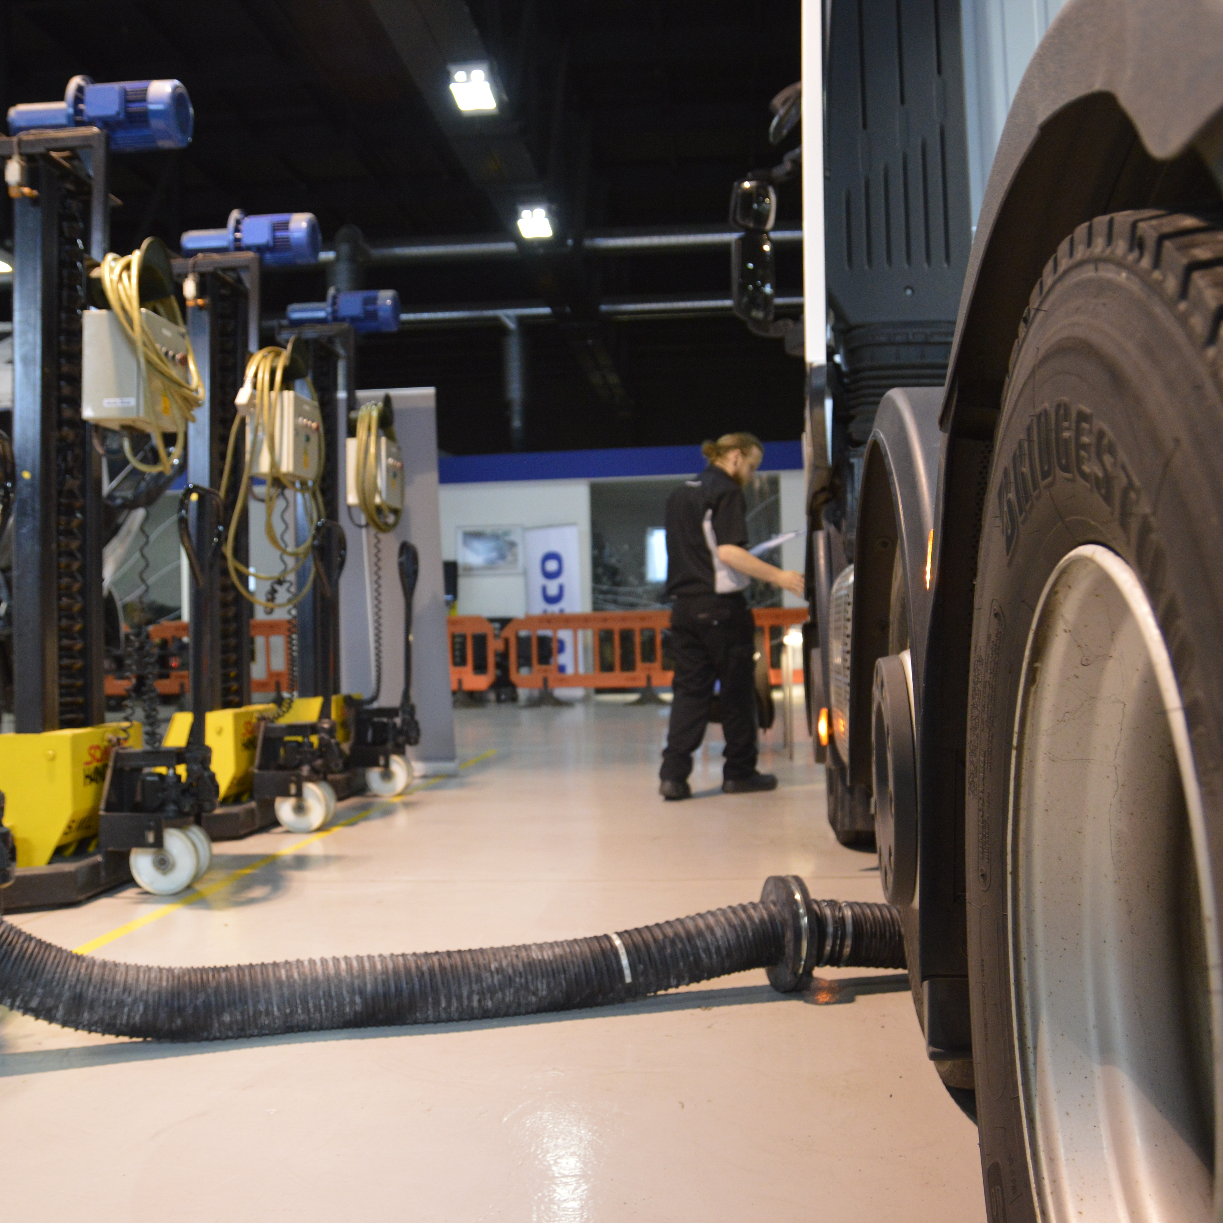
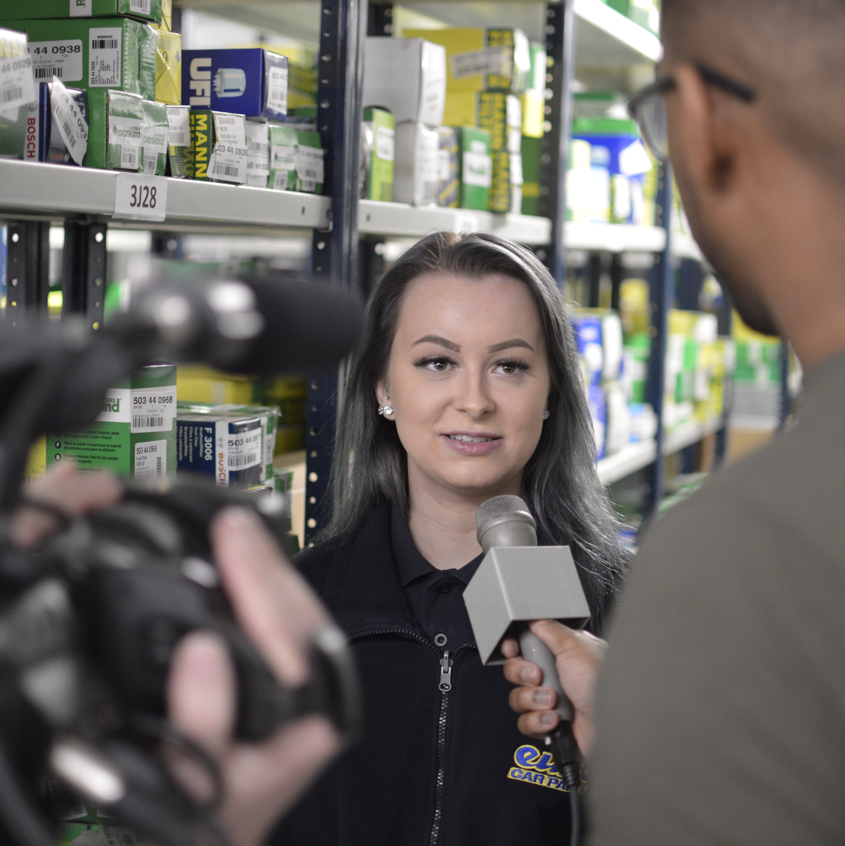
Next steps…
Explore job roles
Find the right apprenticeship for you
Search & apply for your dream apprenticeship job
www.autocity.org.uk/explore-job-roles/
www.autocity.org.uk//find-a-job-apprenticeship/
Jobs.theimi.org.uk
Notes:
Now you know all the great things about apprenticeships what are your next steps?
First explore the job role son offer over at IMI Auto city
Then find the right apprenticeship for you under the find a job or Apprenticeships section
Lastly search and apply for your dream Apprethceips jobs at jobs.theimi.org.uk
If you need any extra support of have any questions get in touch with us at careers@theimi.org.uk and we will be happy to help you

