Slide 1
Art Lesson
Automotive careers

Slide 2
What is the Automotive Industry ?
The automotive industry influences everyone, from delivering goods on time to commuters travelling to work and emerging services being able to respond to crisis, the motor industry helps keep the country moving
There are over 150 jobs in the automotive industry. Any where from sales, lettings and advertising to maintenance, repair and driving.

Slide 3
How does ‘Art’ fit into Automotive careers
There are many jobs in this industry which need creative artistic talent. How many can you think of ?
Use a spider diagram and list as many as you can think of!
Heres a clue:
They aren’t all directly related to working on Cars

Slide 4
Refinishing: These are spray painters and Transfer able designers. They could be covering a repaired patch or putting designs onto vehicles like racing cars
Body Repairers: These are the people that can mould and weld a car back in to its original shape after and accident
Manufacture design: whether it is drawing or clay modelling artists work to get the perfect shape for the latest Vehicles.
Marketing and advertisement: People who design the posters and billboards to help sell the vehicle.
What Jobs are there in the automotive industry?
Photographers and videographers: These people will take pictures or videos of the vehicle for sale or in races.
Brand and logo designers:
Are there any logos you know? E.g. Ferrari has a yellow shield with a black horse.

Slide 5
Now you know a bit more about how art impacts the automotive industry its time to get creative!
Let’s Draw!

Slide 6
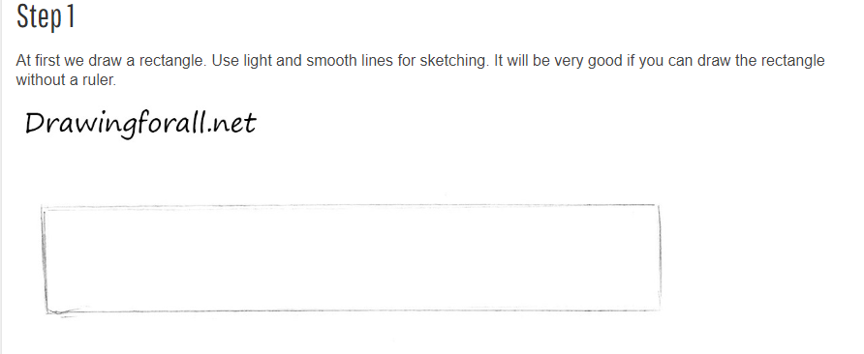

Slide 7
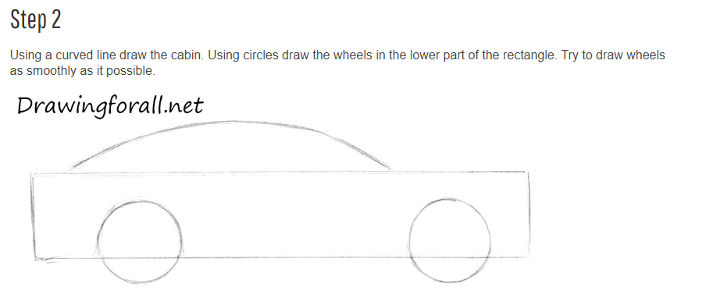

Slide 8
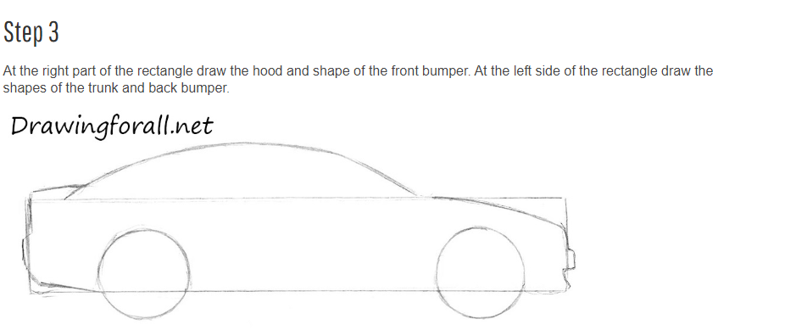

Slide 9
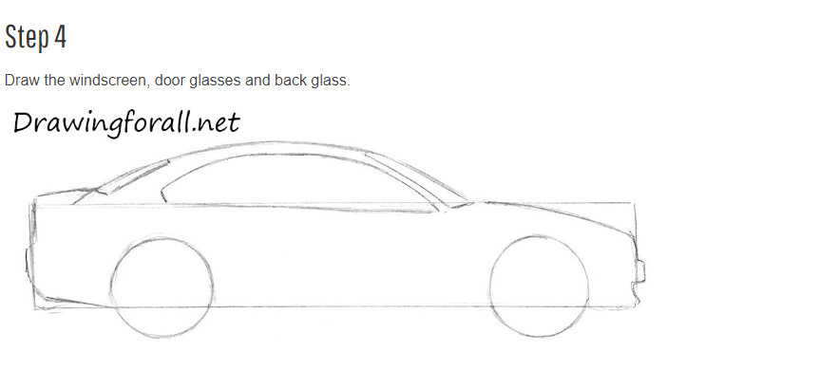

Slide 11
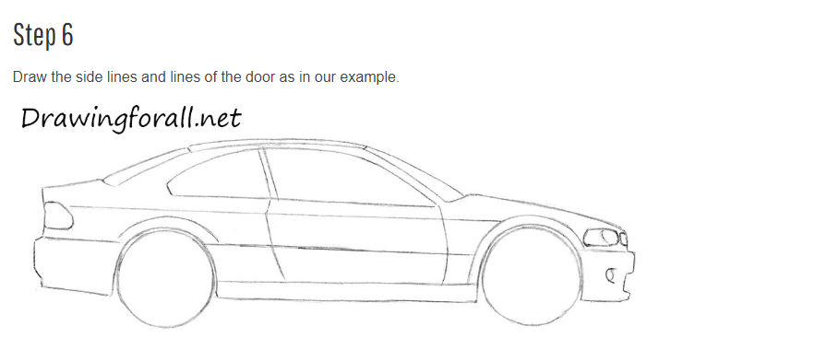

Slide 12
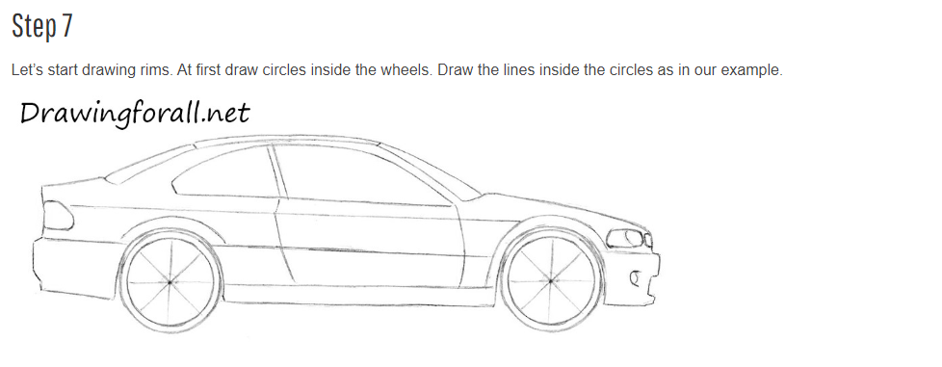

Slide 13
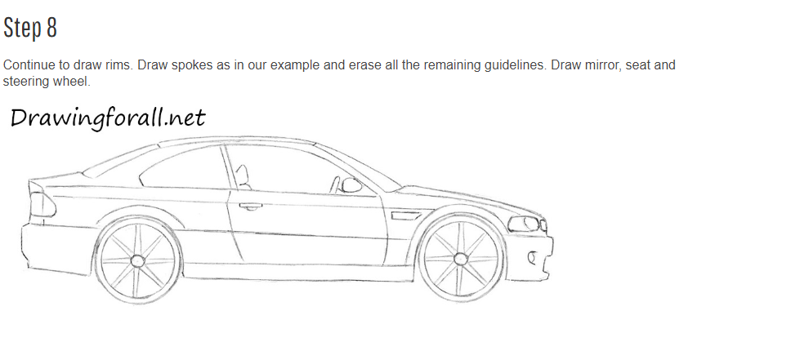

Slide 14
Lastly we would like you to think about who your car is for ?
Who would like the colour?
Who would drive a car like this? How old would they be?
Is it a family car?
Finish off your design with some colours and design and get a short sentence or 2 on who the target audience would be for your new design.

Slide 15
Your vehicles look amazing! You could be the next big designer !
WELL DONE
If you are interested in any of the jobs in the automotive industry or want to explore what else is available then visit. Autocity.org.uk

