Slide 1
#MotorCareers
www.theimi.org.uk/autocity

Slide 2

What is the Automotive sector?
The Automotive Industry influences everyone, from delivering goods to commuters travelling to work and emergency services responding to a crisis.
The Motor Industry helps keep the country moving
There are over 160 roles in the industry and this will grow due to the new demands on electric and autonomous vehicles.
Roles include sales and leasing, maintenance and repair, parts and service advisors, Management and Business and many more!

Slide 3

Who are The IMI
At the IMI, we believe passionately that the automotive sector is a driver of innovation, employment opportunities and economic growth. We also believe that the people working in the industry need the most relevant, up-to-date skills and qualifications in order to progress and thrive – especially during periods of intense change.
IMI’s purpose is to provide, and continuously evolve, the means by which people working in the automotive sector can attain relevant professional competence and appropriate recognition.
The IMI is the only professional body for the whole automotive industry. It’s our mission to make sure that individuals and organisations can meet the exacting standards of professionalism that the digital and AI era will demand.
Our IMI Autocity website is the one-stop-shop for impartial careers information and advice on careers in the Automotive Industry

Slide 4
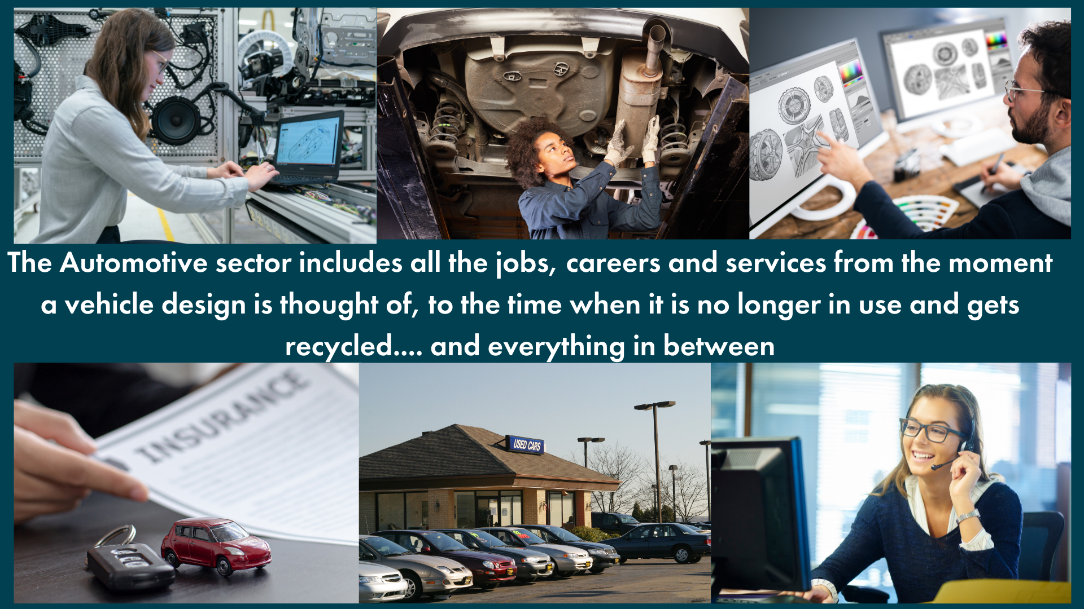

Slide 5
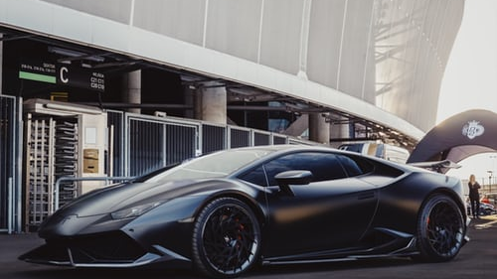
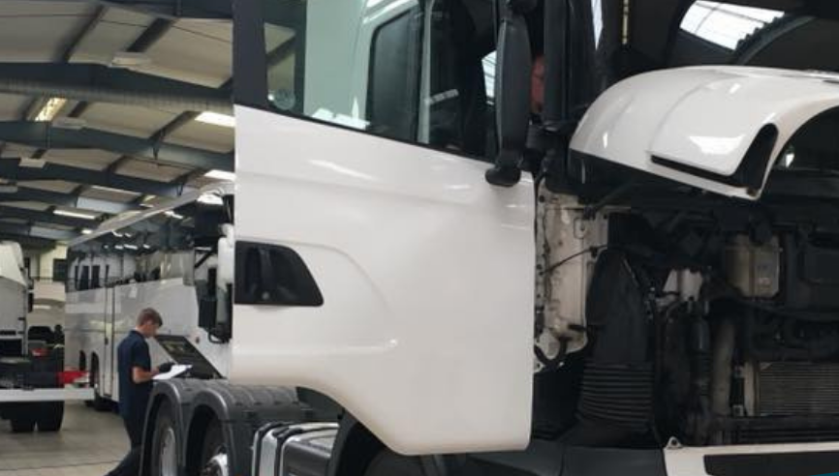
Light Vehicle
Light Vehicle Service Technicians service and repair vehicles such as cars and vans up to 3.5 tonnes. Technicians are trained in all areas of vehicle mechanics and electronics, from engine and exhaust systems to air conditioning and security features.
https://vimeo.com/241538368
Heavy Vehicle
Heavy vehicle service technicians service and repair large vehicles such as lorries and trucks. Technicians are trained in all areas of heavy vehicle mechanics and electronics, from engine and exhaust systems to air conditioning and security features.

Slide 6
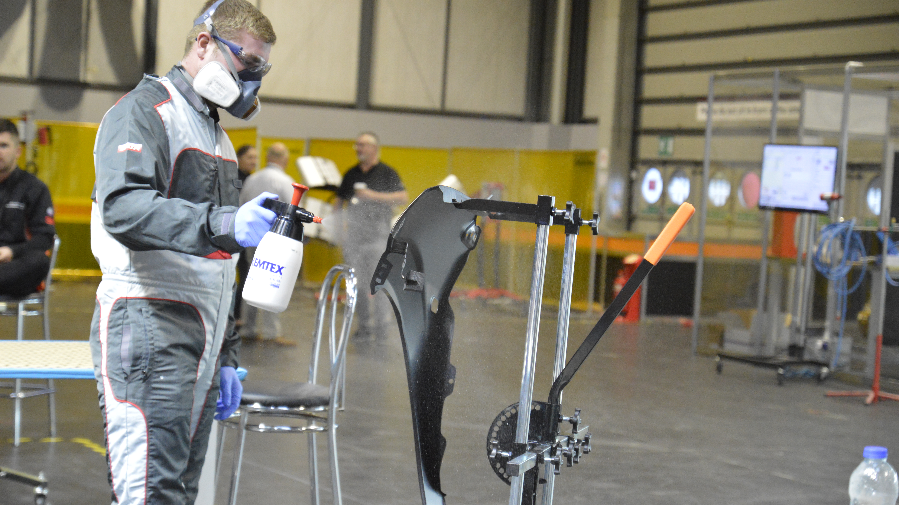
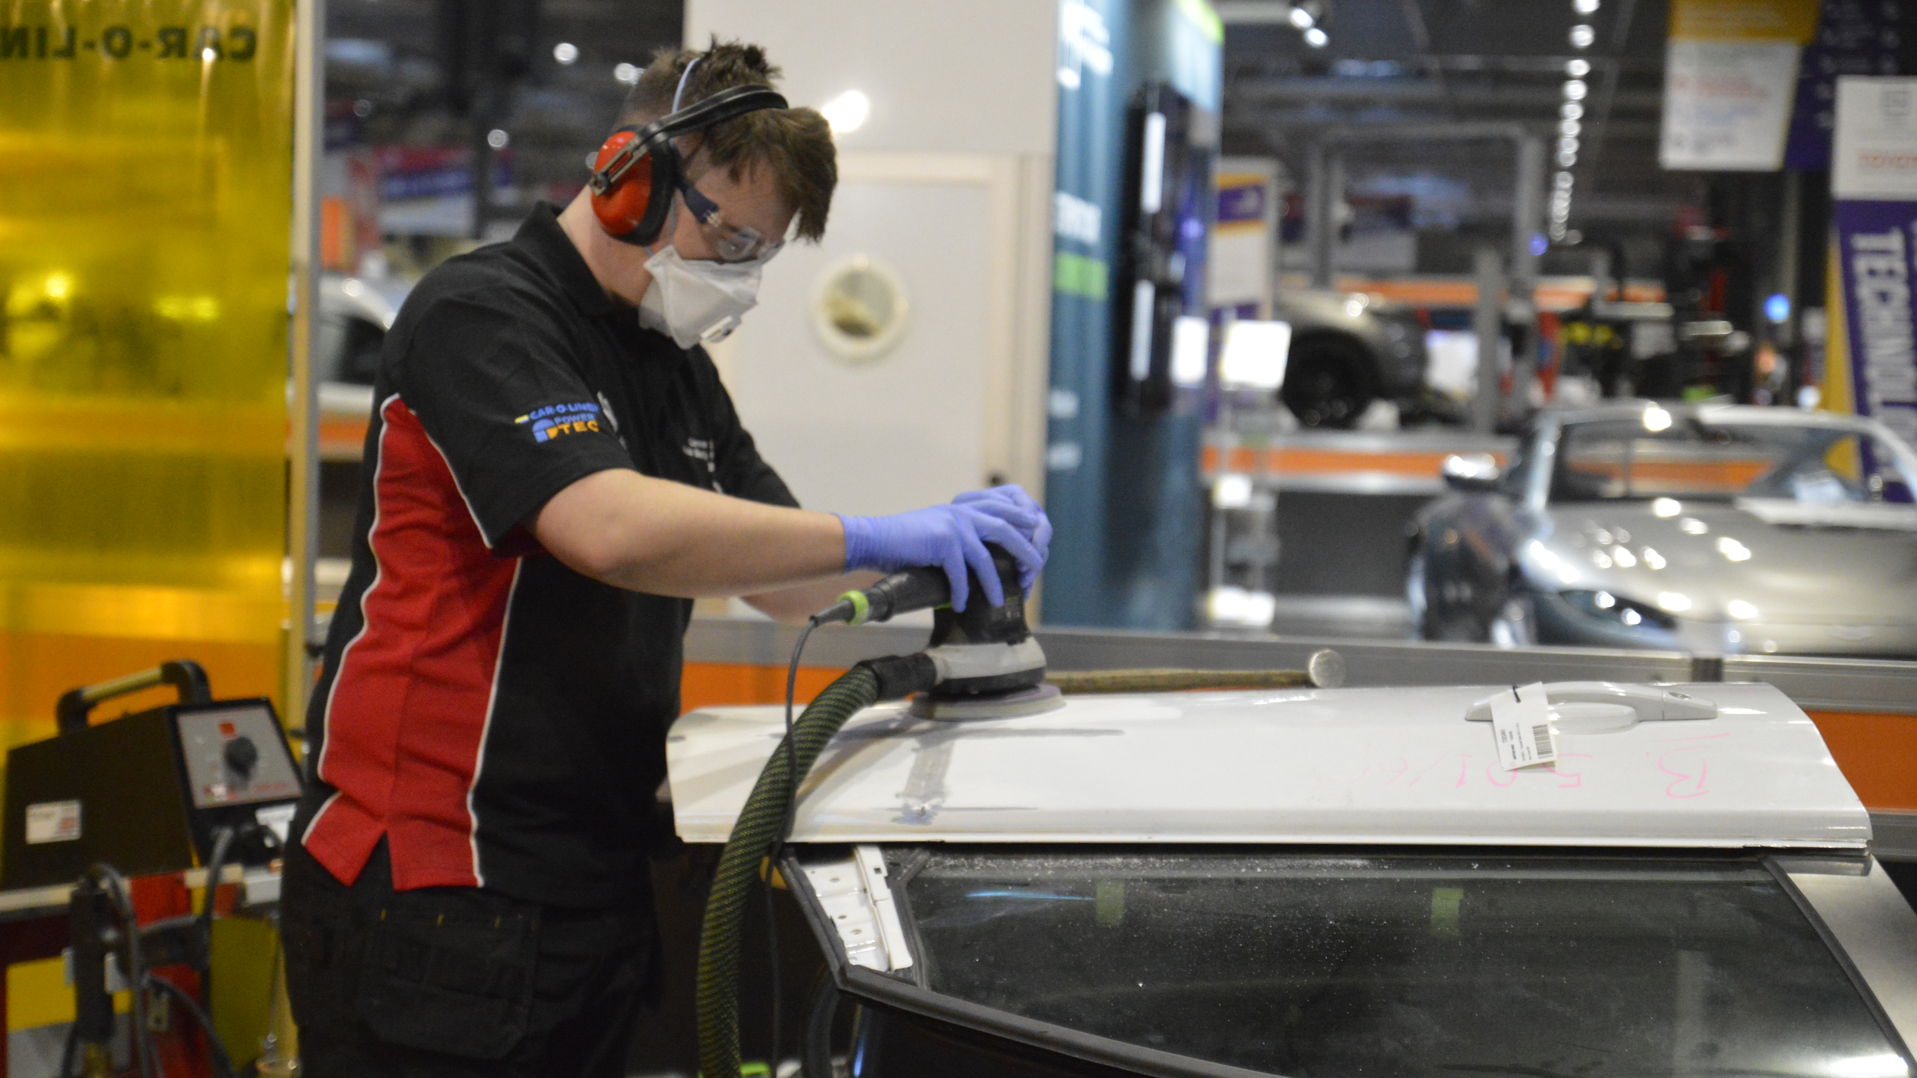
Body Repair
Panel technicians, also known as panel beaters or body repair technicians, specialise in repairing or replacing damaged panels. As a panel technician you will need to demonstrate: Strong communication skills, The ability to work alone and as part of a team, The ability to maintain quality under pressure and an awareness of safety procedures
Paint Technician
Paint technicians are responsible for preparing vehicles to be painted after damage has occurred or panels have been replaced. This will include repairing minor scratches to match the rest of the vehicle.

Slide 7
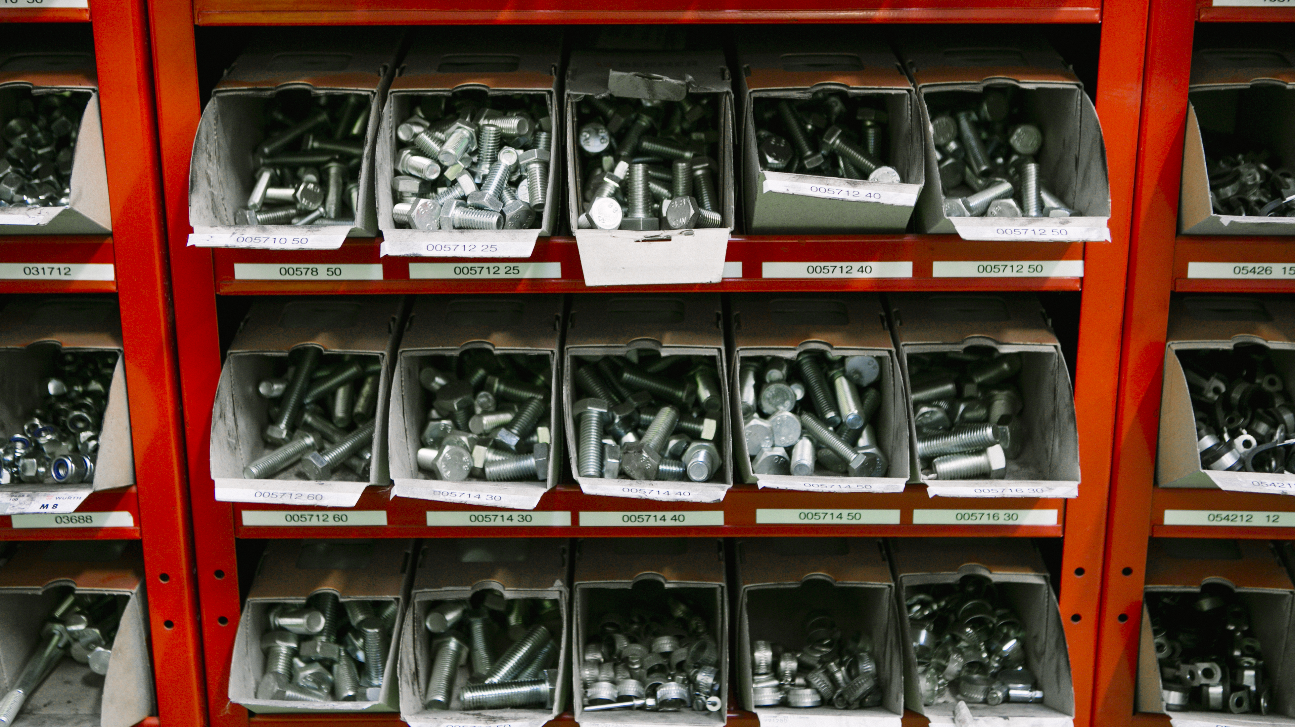

Parts advisor
Parts Advisors are also sometimes known as Vehicle Parts Operatives and they are responsible for ordering, selling and managing stock control on a wide range of vehicle parts and accessories.
Sales executive
Sales Executives are responsible for selling new and used vehicles from cars and motorcycles to vans and commercials trucks. In larger organisations you will work as part of a team or specialise in one aspect of selling however in smaller organisations you may be responsible for all aspects of vehicle sales.

Slide 8
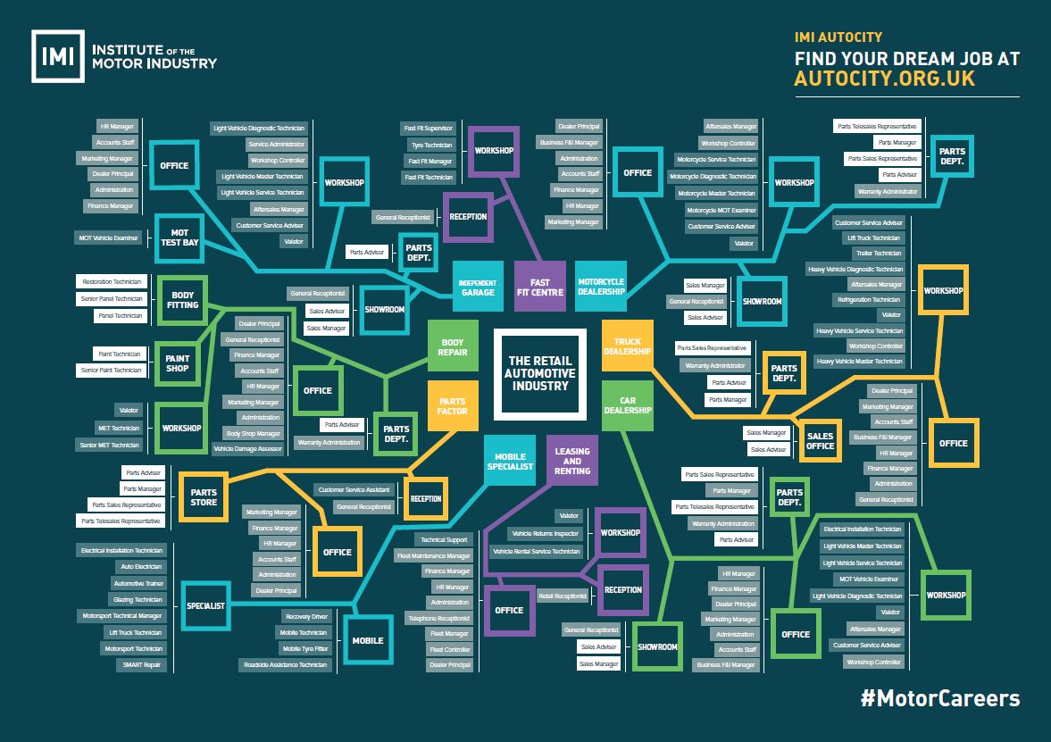
There is something for everyone
With over 160 different job roles in:
Business support, HR, Marketing, Finance services,
Technical, Engineering, Design, manufacturing
Management and Leadership
Notes:
Something for everyone from The Automotive Industry covers anything between a car leaving a manufacturer to being scrapped
It influences everyone, from delivering goods to commuters travelling to work and emergency services responding to a crisis.
The Motor Industry helps keep the country moving
There are over 160 roles in the industry and this will grow due to the new demands on electric and autonomous vehicles.
Roles include sales and leasing, maintenance and repair, parts and service advisors, Management and Business and many more!

Slide 9
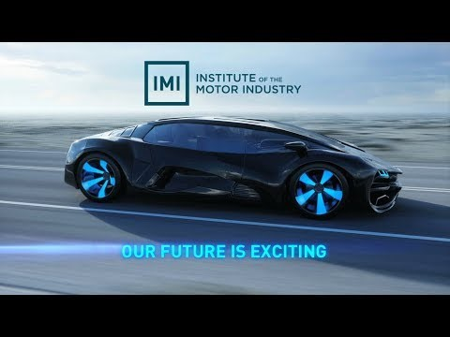
Our future is exciting…be part of it!

Slide 10

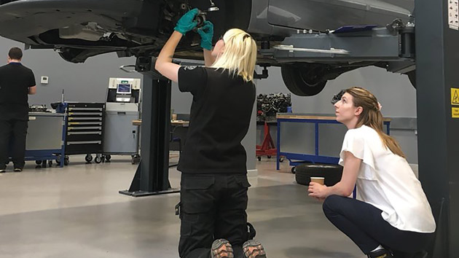
Skills
Important for you to be success in any career is…
Drive and Ambition | Willingness to challenge yourself | Problem solving | Ability to follow instructions | Dynamic | Good Communication Skills | Curiosity | Team Work
Subjects to study
STEM subjects (Science, Technology, Engineering and Maths)
English
Computer science
Art and design
Business and Economics
Notes:
Subjects to study
STEM subjects (Science, Technology, English and Maths)- These are important at GCSE level, some can be retaken or completed as a functional skill. These will be looked into for most careers post 16.
Computer science- Due to the rise in electric vehicle and computerised systems this will be much more in demand
Art and design- Refinishing and body repair needs a keen eye for detail to deal with accident repair all the way to logos and sponsors for formula 1 cars.
Business and Economics – Anywhere from car valeting business up to dealer ownership would benefit from subject such as these.
Skills required

Slide 11

Routes into the sector
Full time education- A-levels, College courses
Apprenticeships – Entry(2) and Advanced level(3)
University- Degree, Graduate schemes
Notes:
It is also very accessible with multiple entry routes form full time study at a college or training provider, to apprenticeship where you earn and learn to A levels and university entries with graduate schemes available.

Slide 12
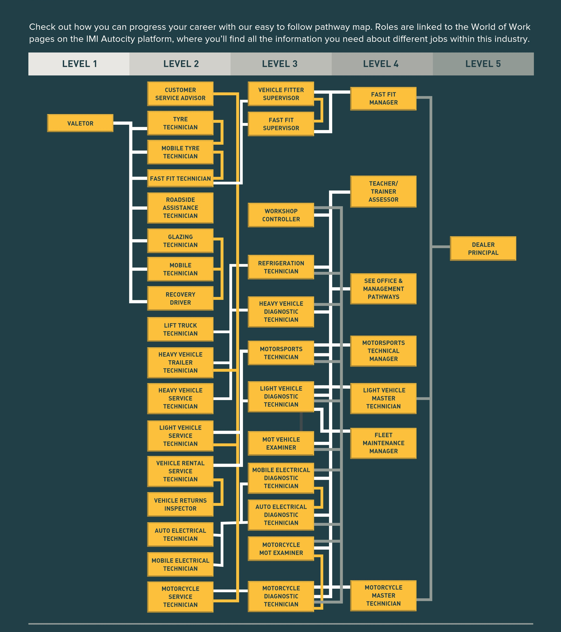
Career progression
From apprentice to CEO
From competitions to F1 team.
Notes:
One of the best things about the industry is the progression routes. They are clearly mapped with salary increase as you progress through the levels of learning and development. A number of CEO’s started their careers as apprentices.
Competitions to F1 teams.

Slide 13
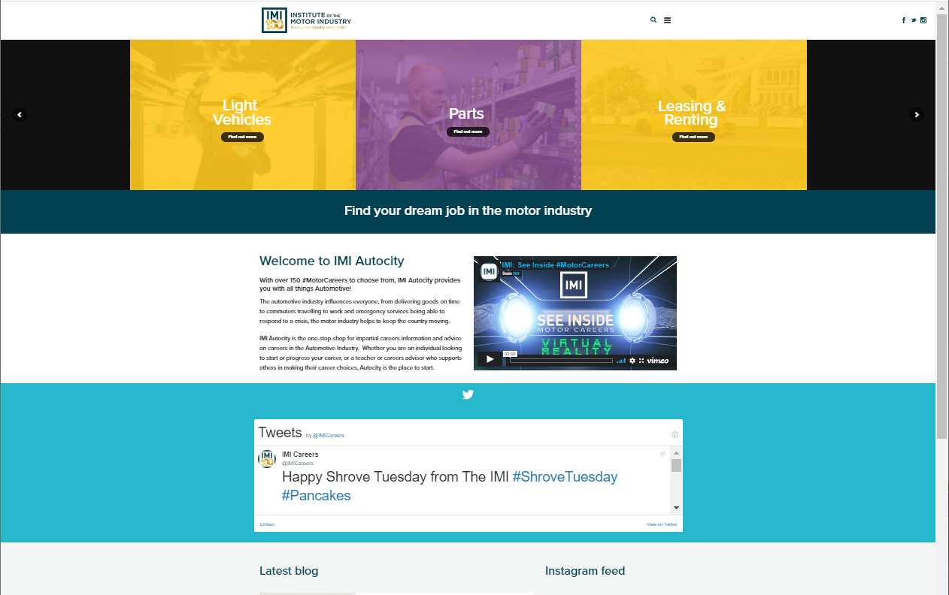
Find out more
Web: www.theimi.org.uk/autocity
Email: careers@theimi.org.uk
Social:
Instagram @IMIautocity
Facebook @AutocityCareers
Twitter @IMIcareers
Notes:
If you want to find out how to start your journey into the wonderful world of #MotorCareers then search out IMI Autocity

