Slide 1

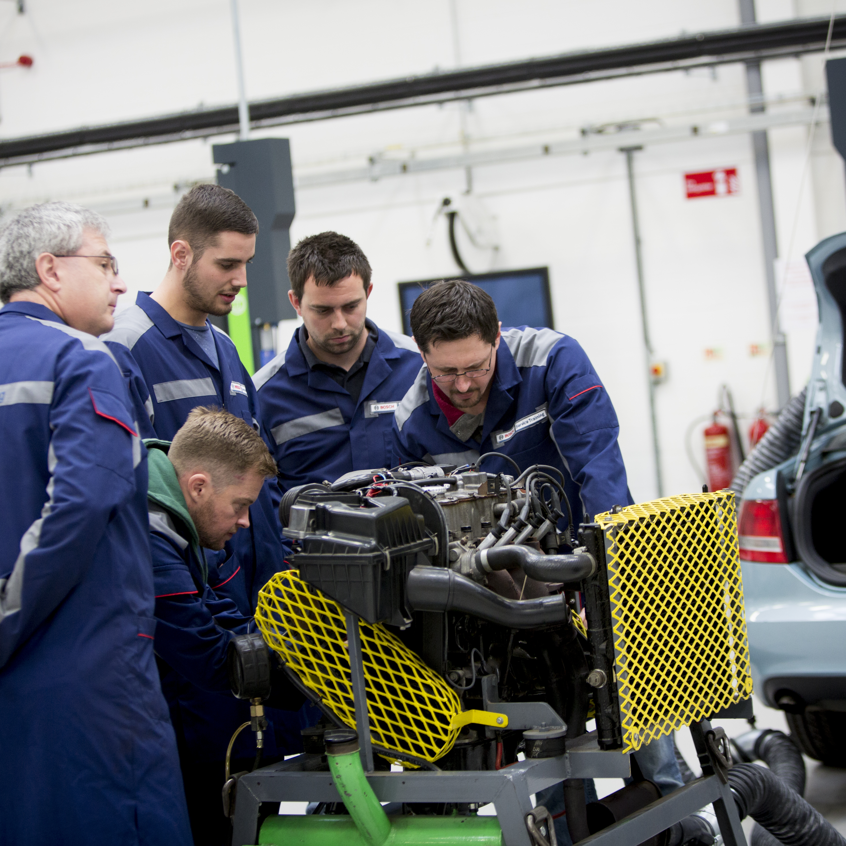
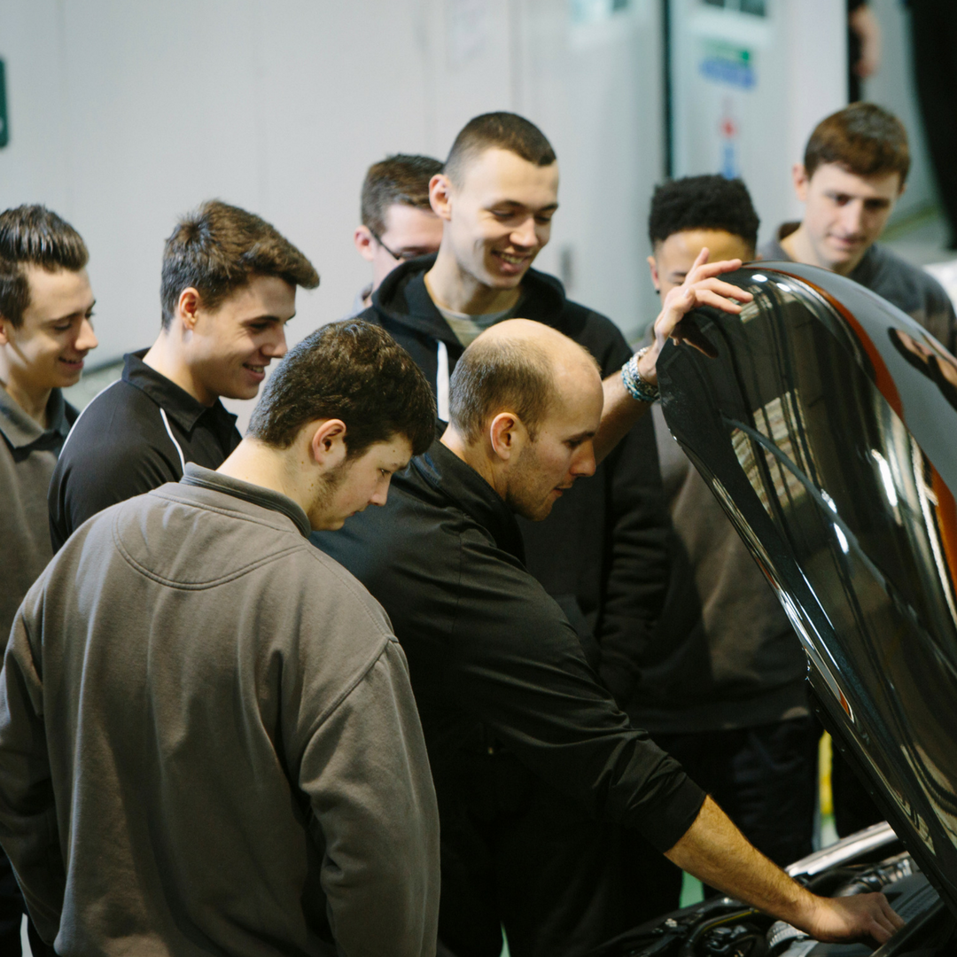
What are my choices after school?
Full time college
Apprenticeship
A Levels and University
2.5 days a week at a college learning theory and practical skills, this option is great if you are not ready to joining the workforce just yet
Either ‘block release’ working for a number of weeks then a week at a training provider or ‘day release’ working 4 days a week and 1 day at college. You will get paid and learn valuable work place skills alongside your qualification
If you are looking at studying Engineering or Design

Slide 2
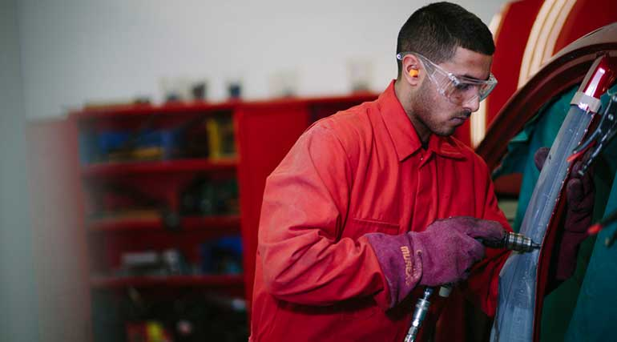

How much wilI be earning?
Before getting into a career, it is nice to know what you can be earning! With the industry having over 150 job roles, each paying a different amount, going through all of them would take a while! So below are a few examples of roles and what you can earn through them.
You can visit www.autocity.org.uk to view more jobs and the income!
Examples of what I can earn:
Light Vehicle Service Technician- £22,000-£45,000
Sales Executive- £18,000- £50,000+
Vehicle Damage Assessor- £25,000- £35,000
Marketing Manager- £25,000- £40,000
Hybrid and Electric Vehicle Technician- £22,000- £45,000

Slide 3

Try it out first…
Enter our ‘Design the Future’ competition and win an amazing experience day out for your school team:
Step 1: download your work plan http://www.autocity.org.uk/index.php/competitions-events/
Step 1: Identify your target market
Step 2: Design your unique selling point, logo, brand and strapline
Step 3: Design your vehicle
Step 4: Plan your vehicle launch
Step 5: send in your designs to careers@theimi.org.uk

Slide 4

Now it’s time to explore…
Visit www.theIMI.org.uk/AutoCity and see which job role is for you

