Slide 1
Everything you need to know about a Career in the Retail Automotive Industry

Slide 2

Our future is exciting…be part of it
https://www.youtube.com/watch?v=Cgv4QxUYArc

Slide 3
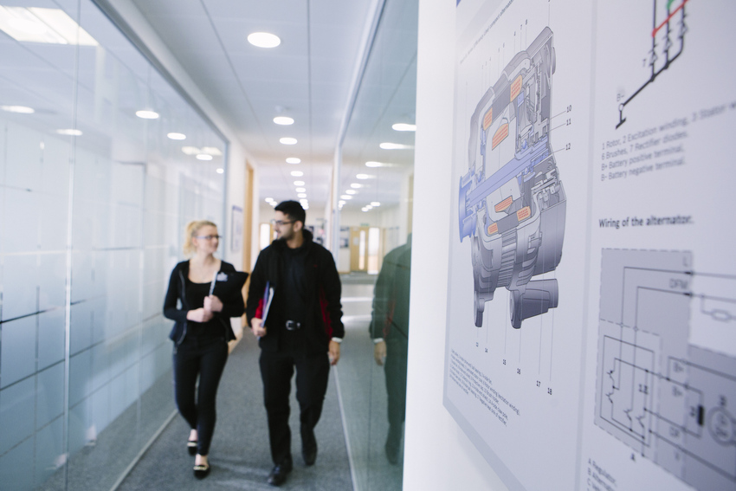
What is the retail automotive industry?
Covers everything from when a vehicle leaves the production line, to the moment it gets scrapped.
150+ roles available which are increasing due to the demand on electric vehicles
There is over 825,000 individuals in the UK alone working in automotive retail.
Over 39,985,260 vehicles on the road
Salaries range from £7k per year as an Apprentice to over £100k per year as a Dealer Principal.
20,000 new recruits needed in 2020
The UK automotive industry is worth more than £82 billion adding £18.6 billion value to the UK economy.
There will always be vehicle on our roads and these need to be repaired and maintained. On top of these we need people to sell the vehicle an their parts meaning there are roles in Designing, Selling, Fixing, Spray painting... the list is huge!

Slide 4
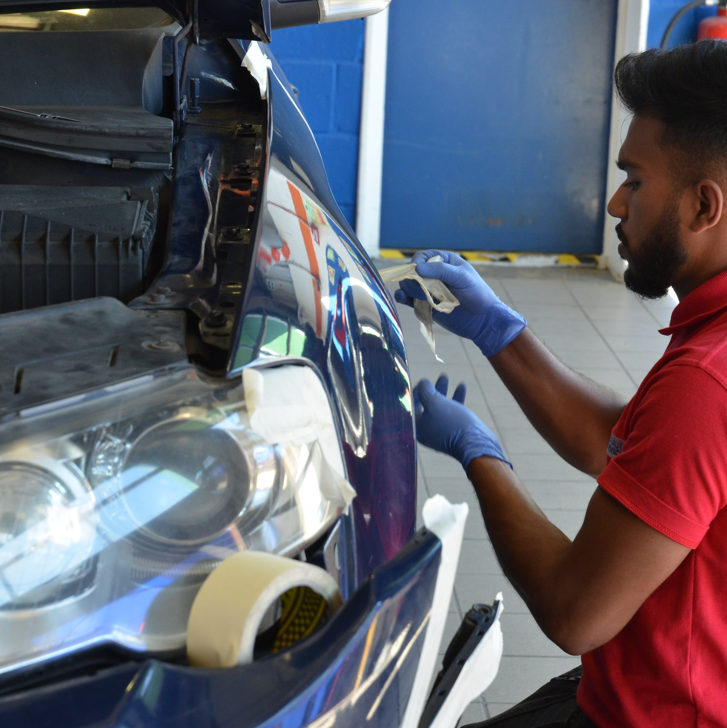


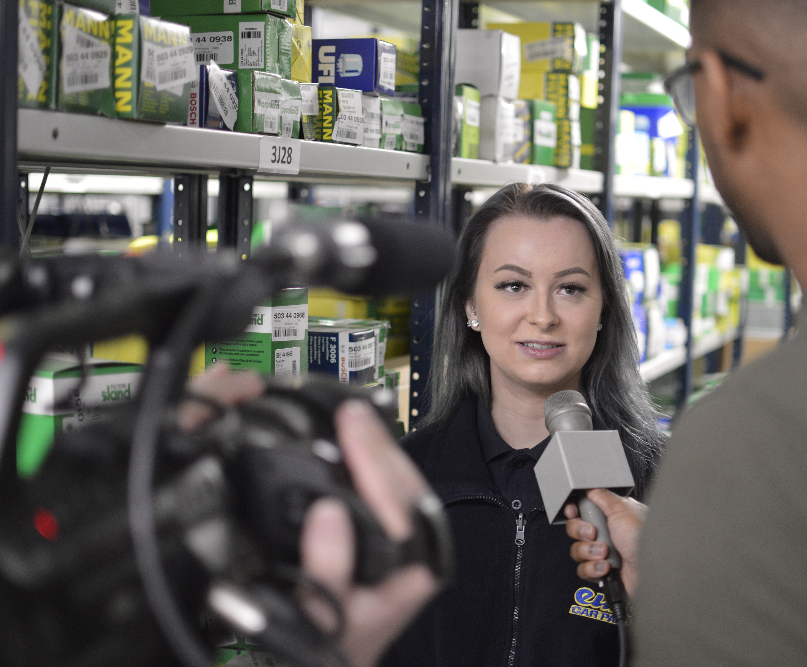

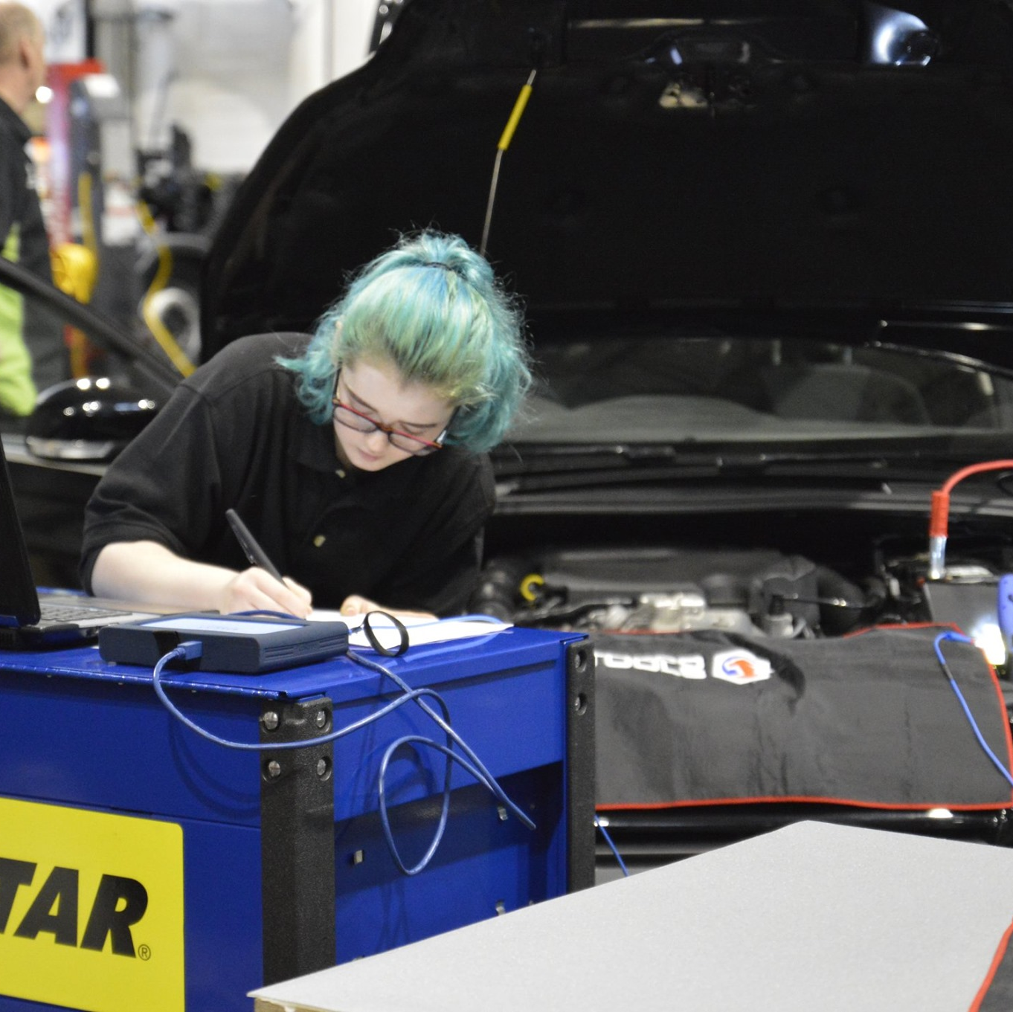


Some of the role you could consider
Body Repair Technician or Refinishing Technician
Internet marketing
Parts
Sales and Leasing
Light, Heavy Vehicle or Motorcycle Technician
Electric and Hybrid Maintenance and repair
With so many careers out there, you can explore more about each role, salaries and qualifications on TheIMI.org.uk/autocity
Human Resources Coordinator & Director

Slide 5
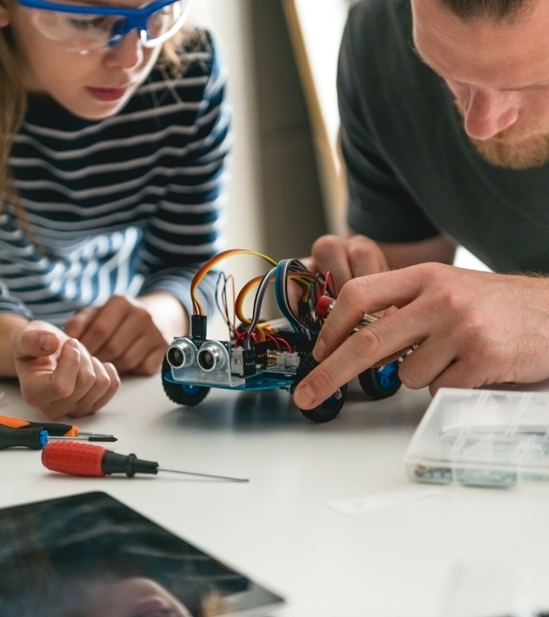
What skills will you need?
There are skills desired within the automotive industry that are important wherever you go! Below are a few:
STEM subjects
Problem solving skills
Good people skills and communication
Attention to detail
A good work ethic

