Slide 1
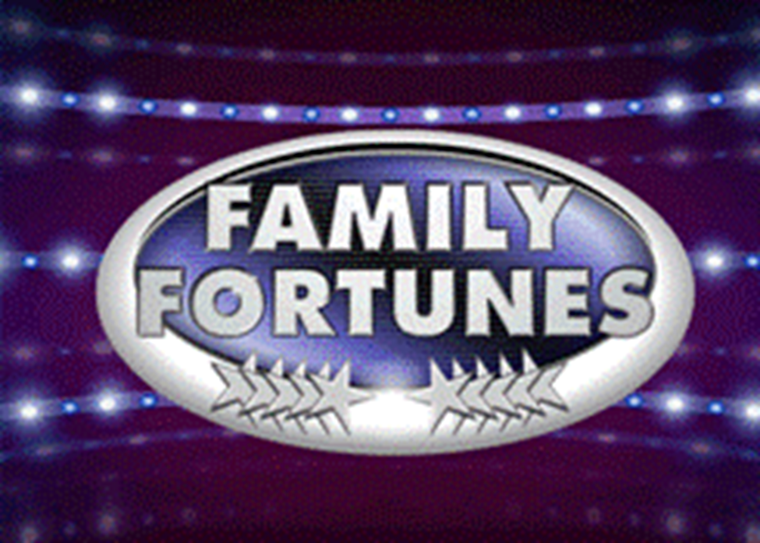
Automotive

Slide 2
Lesson 1

Slide 3


We asked 100 people…
1. Name an animal that would not fit into a Smart Car …
Elephant
Lion
Hippo
Giraffe
Mouse
43%
18%
16%
14%
9%

Slide 4
We asked 100 people…
2. What are the most popular car colours in the UK?
Silver
Black
Blue
Red
White
41%
17%
16%
15%
11%

Slide 5
We asked 100 people…
3. What are the most crashed cars in the UK?
Renault Clio
Ford Fiesta
Alfa 147
Porsche Boxster
BMW Convertible
38%
20%
18%
15%
9%

Slide 6
We asked 100 people…
4. What are the most popular cars of all time in the UK?
Ford Fiesta
Ford Escort
Vauxhall Astra
Ford Cortina
Vauxhall Corsa
45%
28%
12%
8%
7%

Slide 7
We asked 100 people…
5. Name 5 of the most reliable car brands …
Honda
Toyota
Lexus
Suzuki
Subaru
36%
30%
21%
9%
4%

Slide 8
We asked 100 people…
6. Name 5 of the most unreliable car brands …
Land Rover
BMW
Porsche
Volvo
Mercedes
39%
22%
16%
14%
9%

Slide 9
Lesson 2

Slide 10
We asked 100 people…
7. Name 5 past and present Top Gear presenters …
Jeremy Clarkson
Richard Hammond
James May
Chris Evans
Matt Le Blanc
43%
28%
12%
11%
6%

Slide 11
We asked 100 people…
8. Name 5 of the most popular Top Gear presenters from both past and present …
Jeremy Clarkson
Richard Hammond
James May
Matt Le Blanc
Chris Evans
39%
31%
15%
9%
6%

Slide 12
We asked 100 people…
9. Name the oldest, past and present, Top Gear presenters …
Jeremy Clarkson
James May
Chris Evans
Matt Le Blanc
Richard Hammond
34%
33%
30%
2%
1%

Slide 13
We asked 100 people…
10. Name the youngest, past and present, Top Gear presenters …
Richard Hammond
Matt Le Blanc
Chris Evans
James May
Jeremy Clarkson
46%
43%
6%
3%
2%

Slide 14
We asked 100 people…
11. Name 5 of their most favourite cars as featured on Top Gear …
Lamborghini
Ferrari
Audi
BMW
Alfa Romeo
28%
26%
24%
15%
7%

Slide 15
We asked 100 people…
12. Name 5 ‘supercars’…
Bugatti
Ferrari
Aston Martin
Lamborghini
Porsche
24%
22%
21%
19%
14%

Slide 16
Lesson 3

Slide 17
We asked 100 people…
13. Name 5 of the top selling motorbikes …
Yamaha MT-09 Tracer
Honda CBF 125 M
BMW R 1200 S
BMW S1000 RR
Honda CBR 125 R
35%
25%
18%
13%
9%

Slide 18
We asked 100 people…
14. Name 5 major motorbike race circuits in the UK …
Brands Hatch
Silverstone
Oulton Park
Donnington Park
Anglesey
36%
31%
16%
14%
3%

Slide 19
We asked 100 people…
15. Name 5 common reasons for motorcycle accidents in the UK …
Bends on country roads
Collisions at junctions
Collisions while overtaking
Loss of control
Road surface conditions
43%
28%
15%
8%
6%

Slide 20
We asked 100 people…
16. Name 5 of the most famous motorcycle racing World Champions …
Valentino Rossi
Jorge Lorenzo
Marc Marquez
Danni Pedrosa
Bradley Smith
48%
20%
17%
9%
6%

Slide 21
We asked 100 people…
17. Name 5 commonly replaced parts on a motorcycle (due to wear & tear) …
Tyres
Brake pads
Oil filter
Air filter
Bulbs
37%
30%
13%
12%
8%

Slide 22
We asked 100 people…
18. Name 5 commonly modified motorcycle parts …
Exhausts
Brake pads
Mirrors
Windscreens
Crash protection
32%
24%
18%
16%
10%

Slide 23
We asked 100 people…
19. Name 5 job roles related to motorcycles …
Service/Parts Advisor
Motorcycle technician
Motorcycle sales executive
Ignition component engineer
Mechanical/Restoration engineer
35%
31%
23%
8%
3%

Slide 24
We asked 100 people…
20. Name 5 popular motorcycle colours …
Black
Silver
Blue
Red
White
38%
23%
17%
15%
7%

Slide 25
Lesson 4

Slide 26
We asked 100 people…
21. Name 4 cars from a TV programme …
Batmobile
Kit (from Knightrider)
The Mystery Machine
Herbie
38%
22%
21%
19%

Slide 27
We asked 100 people…
22. Name 5 films featuring cars …
Fast & Furious
Transformers
Chitty Chitty Bang Bang
The Italian Job
Gone in 60 Seconds
27%
22%
19%
17%
15%

Slide 28
We asked 100 people…
23. Name 5 commonly misspelt car names …
Lamborghini
Ferrari
Subaru
Porsche
Mitsubishi
46%
29%
10%
8%
7%

Slide 29
We asked 100 people…
24. Name 5 car manufacturers that often advertise on TV …
Renault
Toyota
Volkswagen
Peugeot
Citroen
34%
28%
20%
17%
5%

Slide 30
We asked 100 people…
25. Name 5 car manufacturers …
BMW
Ford
Audi
Volkswagen
Vauxhall
32%
28%
20%
12%
8%

Slide 31
We asked 100 people…
26. Name 5 companies who offer car insurance …
Direct Line
Aviva
Tesco
Churchill
LV
39%
26%
18%
10%
7%

Slide 32
Lesson 5

Slide 33
We asked 100 people…
27. Name 5 of the most expensive cars in the world …
Bugatti Veyron
Lamborghini
Ferrari
Pagani Zonda
Aston Martin
41%
17%
16%
15%
11%

Slide 34
We asked 100 people…
28. Name 5 manufacturers beginning with the letter ‘m’ …
Maserati
Mercedes Benz
Mazda
Mini
Mitsubishi
39%
26%
18%
10%
7%

Slide 35
We asked 100 people…
29. Name 5 manufacturers beginning with the letter ‘s’ …
Saab
Subaru
Skoda
Seat
Smart
38%
20%
18%
15%
9%

Slide 36
We asked 100 people…
30. Name 5 German car manufacturers …
Audi
Mercedes Benz
BMW
Volkswagen
Porsche
37%
28%
19%
11%
5%

Slide 37
We asked 100 people…
31. Name 5 car manufacturers whose logo feature an animal …
Ferrari (horse)
Porsche (horse)
Lamborghini (bull)
Jaguar
Alfa Romeo (dragon)
40%
27%
13%
11%
9%

Slide 38
We asked 100 people…
32. Name 5 car manufacturers whose logos are completely silver …
Audi
Mercedes Benz
Renault
Toyota
Honda
36%
22%
20%
13%
9%

Slide 39
Lesson 6

Slide 40
We asked 100 people…
33. Name 5 car tyre brands …
Continental
Michelin
Goodyear
Pirelli
Bridgestone
31%
29%
22%
10%
8%

Slide 41
We asked 100 people…
34. Name 5 petrol brands that you see out and about …
Shell
BP
Esso
Texaco
Total
26%
23%
22%
17%
12%

Slide 42
We asked 100 people…
35. Name 5 different kinds of lights a car has …
Headlight
Indicator
Fog light
Full beam
Reverse light
34%
25%
21%
11%
9%

Slide 43
We asked 100 people…
36. Name 5 safety features designed to protect passengers …
Seatbelts
Airbags
Anti-lock braking system
Traction control
Safety cage
39%
34%
15%
9%
3%

